Slide 1
A SMART APPROACH FOR DETECTING EMAIL SPAM TEXT DETECTION
Sayem Al Mahadi
191-15-12949
Farhana Akter Smritee
191-15-12467
Ahmed Zubayer Sunny
191-15-12960
Narayan Ranjan Chakraborty
Associate Professor
Department of CSE
Daffodil International University
Dhaka.
26th January 2023

Slide 2
Introduction
What is Email?
What is spam email?
Why is it a problem?
How can ML(Machine Learning) help to detect spam emails?

Slide 3
Objective
Good knowledge about algorithms.
Know about the spam detection.
Email can secure from spam text.

Slide 4
Motivation
To detect email spam.
Be wary about forwarding such an article to others.
True emails are revealed.
Preventing the different types of attacks

Slide 5
Related Work
Banday et al. | 4000 data | Regression Tree, Naive Bayes, KNN, SVM | Accuracy 83% (NB)
Islam et al. | 5000 data | DT, SVM, KNN, Ensemble | Accuracy73% (KNN)
Smys et al. | 3000 data | DT, RF, SVM, NB, Hybrid ( SVM-NB) | Accuracy 93% (Hybrid)
ALSAGRI et al | 3500 data | DT, SVM, KNN, Ensemble | Accuracy 92% (DT)

Slide 6
Methodology
Data Collection
Data Pre-processing
Testing
Training
Model Selection & Evaluation
Get the best accuracy
Result

Slide 7
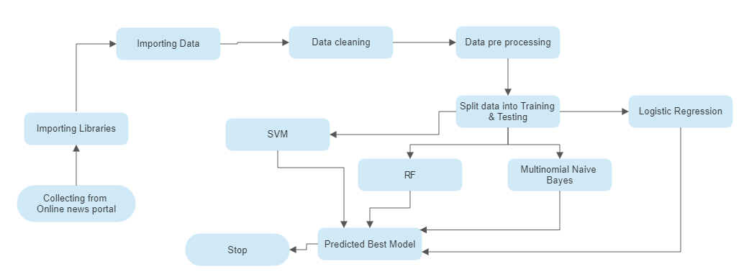
Implementation Process

Slide 8
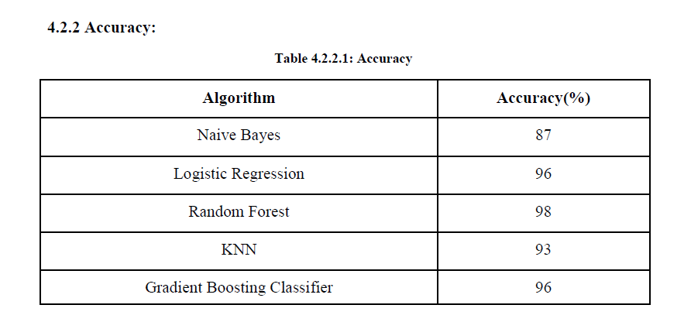
Result and Analysis

Slide 9
Future Work
Increase the accuracy of the model
Build a real-time software to implement the idea
Train the model to detect even more spam emails.

Slide 10
Conclusion
This survey study describes many existing spam filtering systems using machine learning techniques by investigating various approaches, evaluating the effectiveness of various proposed approaches with reference to various parameters, and concluding the overview of various spam filtering approaches. Additionally, all currently used techniques for email spam filtering are efficient. Some have successful results, while others are attempting to use a different technique to improve their accuracy rate. Researchers are working to develop the next generation of spam filtering systems, which will be able to take into account a huge amount of multimedia data and filter spam email more effectively, even if all of the current spam filtering systems are effective.

Slide 11
References
[1] I. AbdulNabi and Q. Yaseen, “Spam email detection using deep learning techniques,” in Procedia Computer Science, 2021, vol. 184, pp. 853–858. doi: 10.1016/j.procs.2021.03.107. Electronic copy available at: https://ssrn.com/abstract=4145123
[2] S. Madisetty and M. S. Desarkar, “A Neural Network-Based Ensemble Approach for Spam Detection in Twitter,” IEEE Trans. Comput. Soc. Syst., vol. 5, no. 4, pp. 973–984, Dec. 2018, doi: 10.1109/TCSS.2018.2878852.
[3] A. Salunkhe, “Attention-based Bidirectional LSTM for Deceptive Opinion Spam Classification,” Dec. 2021, [Online]. Available: http://arxiv.org/abs/2112.14789
[4] A. Hosseinalipour and R. Ghanbarzadeh, “A novel approach for spam detection using horse herd optimization algorithm,” Neural Comput. Appl., Mar. 2022, doi: 10.1007/s00521-022- 07148-x.
[5] P. K. Roy, J. P. Singh, and S. Banerjee, “Deep learning to filter SMS Spam,” Futur. Gener. Comput. Syst., vol. 102, pp. 524–533, Jan. 2020, doi: 10.1016/j.future.2019.09.001.
[6] K Agarwal abd T Kumar, "Email Spam Detection using Integrated approach of Naïve Bayes and Particle Spam Optimation, "IEEE Electron Devices Society, Institute of Electrical and Electronics Engineers, and Vaigai College of Engineering, Proceeding of the 2018 International Conference on Intelligent Computing and Control Systems (ICICCS) : June 14-15, 2018.

Slide 12
References
[7] E. M. Bahgat, S. Rady, W. Gad, and I. F. Moawad, “Efficient email classification approach based on semantic methods,” Ain Shams Eng. J., vol. 9, no. 4, pp. 3259–3269, Dec. 2018, doi: 10.1016/j.asej.2018.06.001.
[8] W. Pan et al., “Semantic Graph Neural Network: A Conversion from Spam Email Classification to Graph Classification,” Sci. Program., vol. 2022, 2022, doi: 10.1155/2022/6737080.
[9] J. Z. Pan, S. Pavlova, C. Li, N. Li, Y. Li, and J. Liu, “Content based fake news detection using knowledge graphs,” in Lecture Notes in Computer Science (including subseries Lecture Notes in Artificial Intelligence and Lecture Notes in Bioinformatics), 2018, vol. 11136 LNCS, pp. 669– 683. doi: 10.1007/978-3-030-00671-6_39.
[10] [41] Kumar, S., Asthana, R., Upadhyay, S., Upreti, N., & Akbar, M. (2020). Fake news detection using deep learning models: A novel approach. Transactions on Emerging Telecommunications Technologies, 31(2), e3767.
[11] B. K. Dedeturk and B. Akay, “Spam filtering using a logistic regression model trained by an artificial bee colony algorithm,” Appl. Soft Comput. J., vol. 91, Jun. 2020, doi: 10.1016/j.asoc.2020.106229.
[12] W. Feng, “2016 IEEE 35th International Performance Computing and Communications Conference, IPCCC 2016,” 2016 IEEE 35th Int. Perform. Comput. Commun. Conf. IPCCC 2016, 2017.
[13] Amanoul, S. V., Abdulazeez, A. M., Zeebare, D. Q., & Ahmed, F. Y. (2021, June). Intrusion Detection Systems Based on Machine Learning Algorithms. In 2021 IEEE International Conference on Automatic Control & Intelligent Systems (I2CACIS) (pp. 282-287). IEEE.
[14] T. Verma and D. C. Rana, “Data Mining Techniques for the Knowledge Discovery,” Int. J. Eng. Technol., vol. 9, no. 3S, pp. 351–354, Jul. 2017, doi: 10.21817/ijet/2017/v9i3/170903s054.

Slide 13
References
[15] D. Tang, B. Qin, and T. Liu, “Document Modeling with Gated Recurrent Neural Network for Sentiment Classification,” Association for Computational Linguistics, 2015. [Online]. Available: http://ir.hit.edu.cn/
[16] A. Ishaq et al., “Extensive hotel reviews classification using long short term memory,” J. Ambient Intell. Humaniz. Comput., vol. 12, no. 10, pp. 9375–9385, Oct. 2021, doi: 10.1007/s12652- 020-02654-z. Electronic copy available at: https://ss-15

